Slide 1
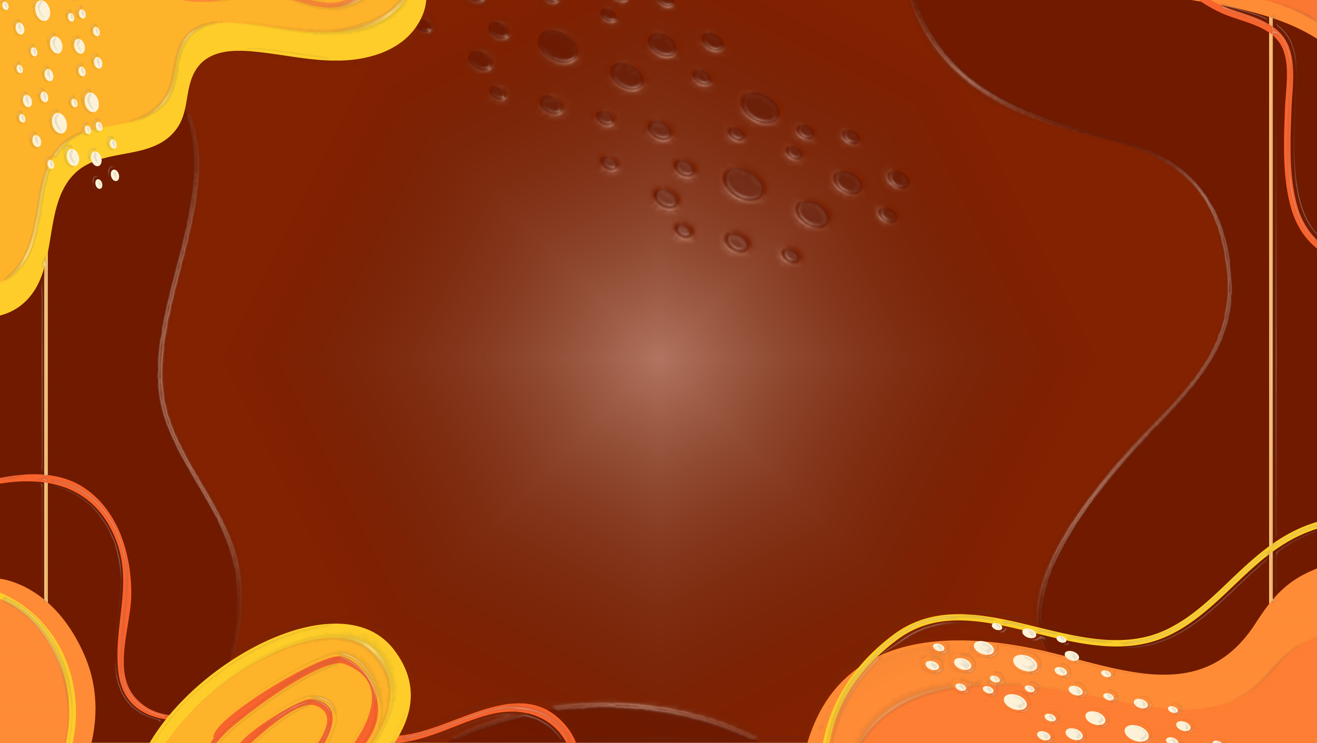

Module 2 - Tutorial
Colonisation and health

Slide 2
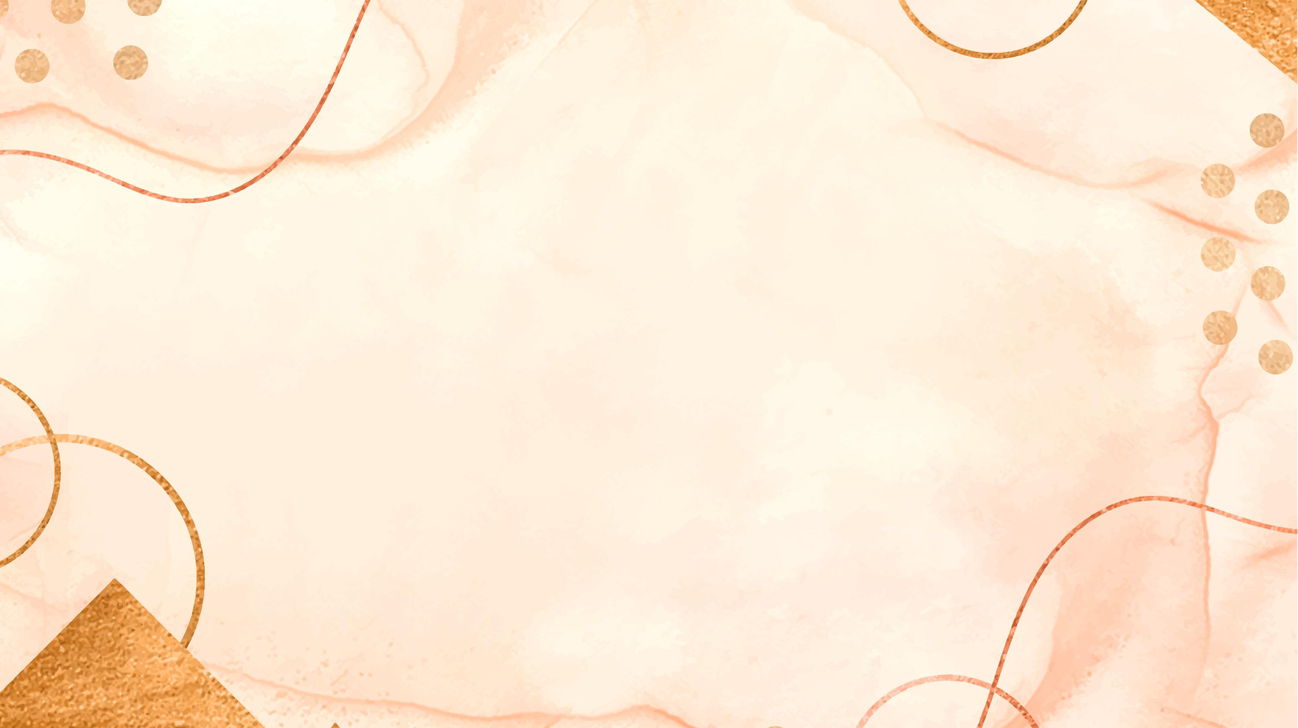
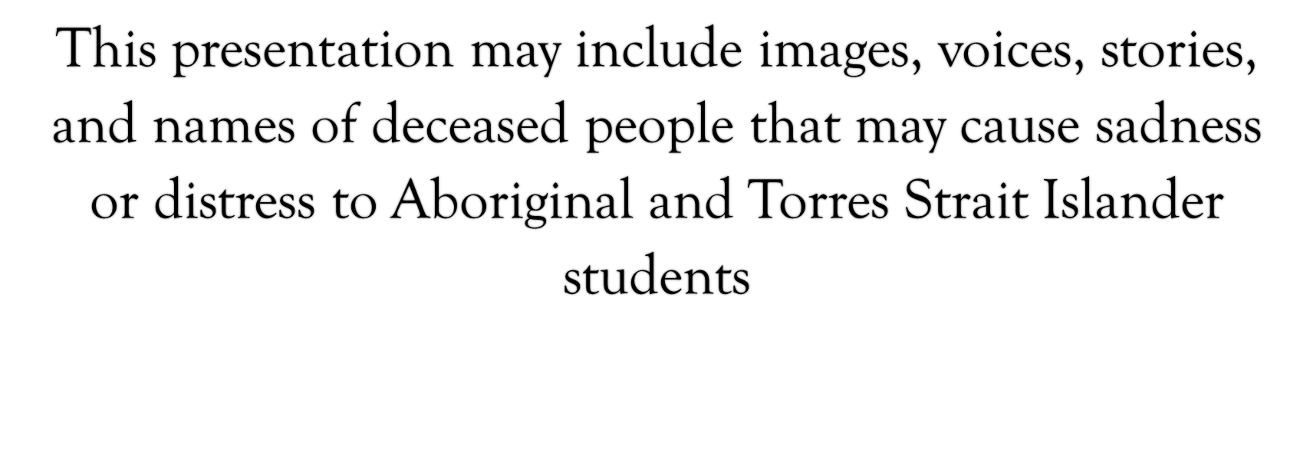
Warning

Slide 3
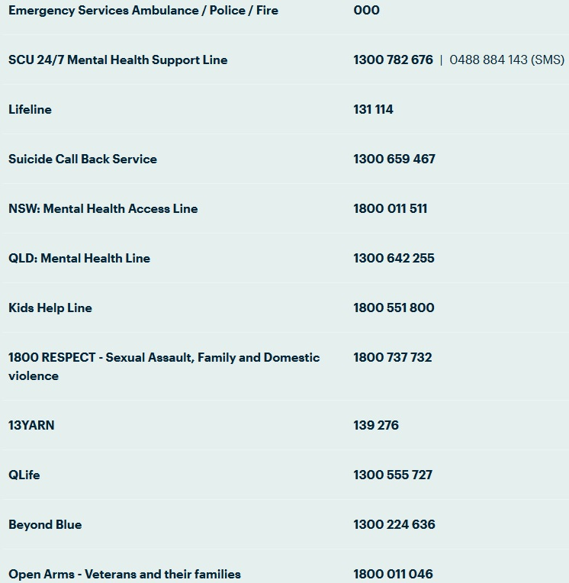

During this module we will be discussing discriminatory events and perceptions that may be triggering to some students due to lived experience. If you ever feel the need to take a break during one of these discussions on reading content, either for a short time or for the rest of the class session, you may always do so without academic penalty.
If students wish to discuss your personal reactions to this material, either with the class or with the Lecturer afterwards, such discussion is welcomed as an appropriate part of our coursework.
SCU help guide: https://www.scu.edu.au/current-students/services-and-support/counselling/after-hours-and-crisis-support/

Slide 4
Module 2
By the end of this module you will be able to:
recognise how colonisation continues to substantially impact the lives of Indigenous Peoples
apply a critical lens to the ongoing damage of ‘Stolen Generations’ on the social, cultural and health status of all Indigenous Peoples in Australia
describe/summarise forms of racism and how they impact Aboriginal and Torres Strait Islander peoples health

Slide 5
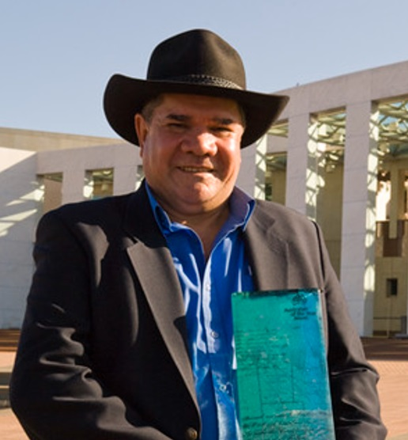
The end in the beginning: re(de)finding Aboriginality
“Our peoples have left us deep roots, which empowered us to endure the violence of oppression. They are the roots of survival, but not of constriction. They are the roots from which all growth is possible. They are the roots that protected our end from the beginning.”
Professor Michael ‘Mick’ Dodson (The end in the beginning: re(de)finding Aboriginality 1994, p. 11)

Slide 6
Cultural Vitality
‘the emotional strength, the spirit, the essence of people who strive and struggle to maintain strong identity and adapt to new and challenging environments, while they value and pass on distinctive cultural beliefs, practices and life ways’
the active and proactive adaptation of culture is assumed and valued
no longer seen as a static, idealised ‘given’ that needs to be ‘gone back to’
consider the innovative, creative and resourceful ways in which people and their communities are adapting
(Taylor & Geurin, p. 152)
Quote: (Eckermann et al., 2010, p. 99 in Taylor & Geurin, 2019, p. 152)

Slide 7
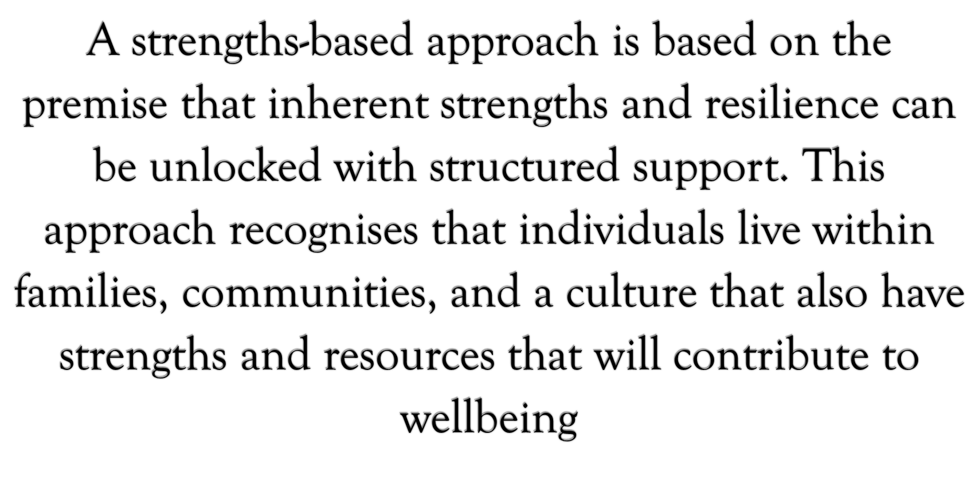

Slide 8
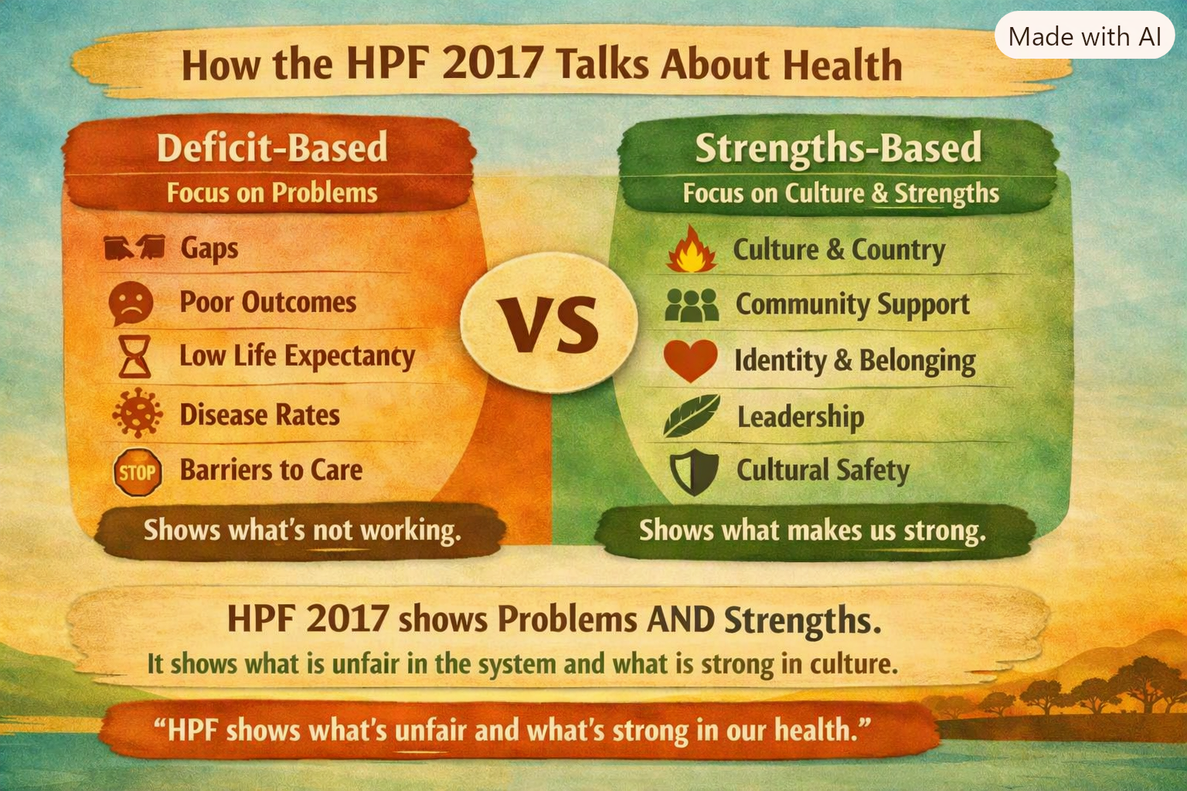
Mapping Module to grass-roots, community-led Indigenous frameworks and approaches
Aboriginal and Torres Strait Islander Health Performance Framework (HPF) 2017

Slide 9

Story: The Lion & the Hunter

Slide 10
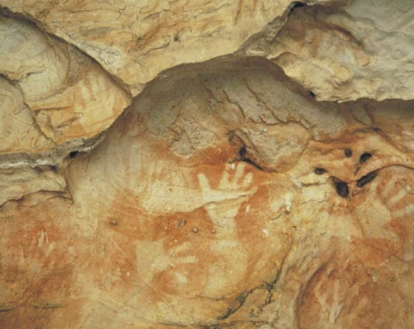
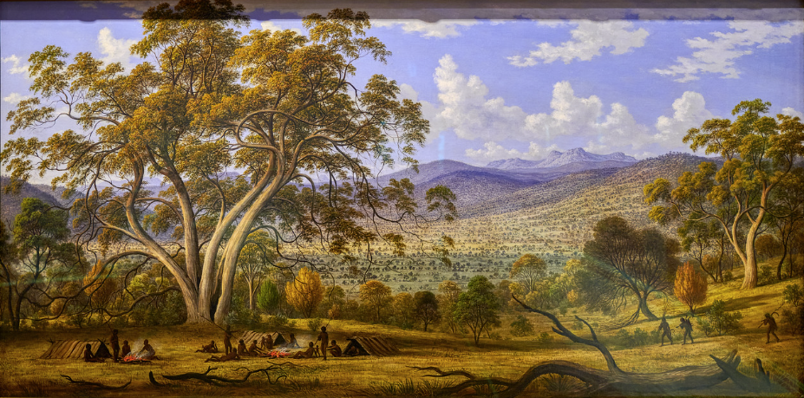
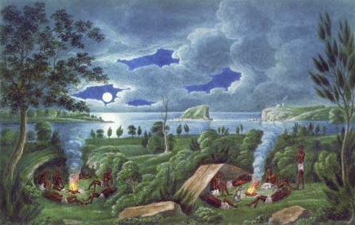
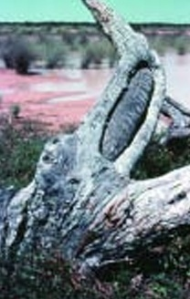
History prior to Colonisation
Image: Hand stencils Manja Shelter Gariwerd (Grampians National Park
Image: Mills’ Plains, Ben Lomond Tas, c. 1832-4 John Glover in The Biggest Estate on Earth Gammage, 2011, p. 19
Image: A bark spear shield (or ‘helimans’)
Department of Environment and Conservation (NSW), Aboriginal scarred trees in NSW, 2005, p. 22
Image: 'Aborigines Resting by a Camp Fire near the Mouth of the Hunter River, Newcastle, NSW' (Joseph Lycett, c. 1820s). This scene may have been typical of Aboriginal life on the coastal belt during the early settlement of New South Wales (Courtesy National Library of Australia: R5684).

Slide 11
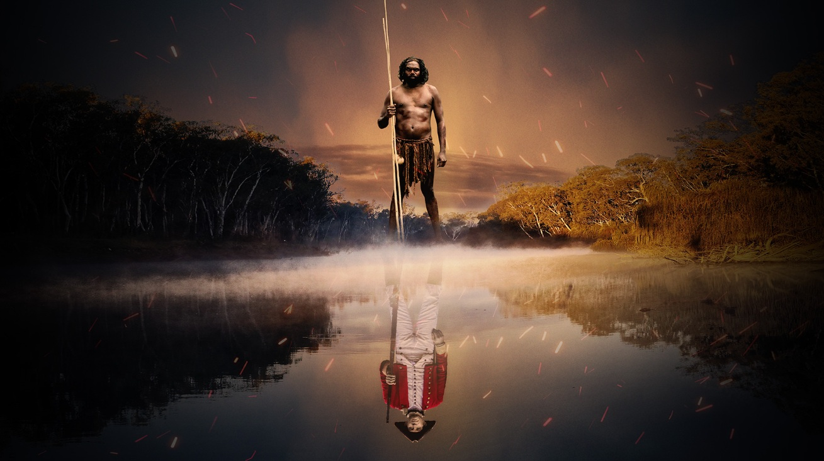
History since Colonisation
Image: auswars_169_keyarttitle_1920x1080 Rachel Perkins Dale Hickey Watson 2023

Slide 12
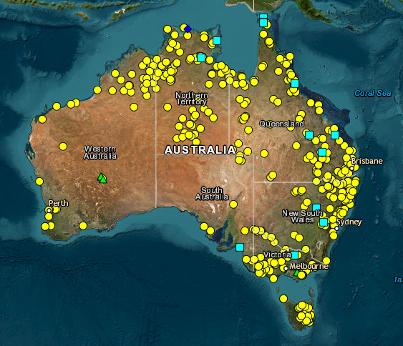
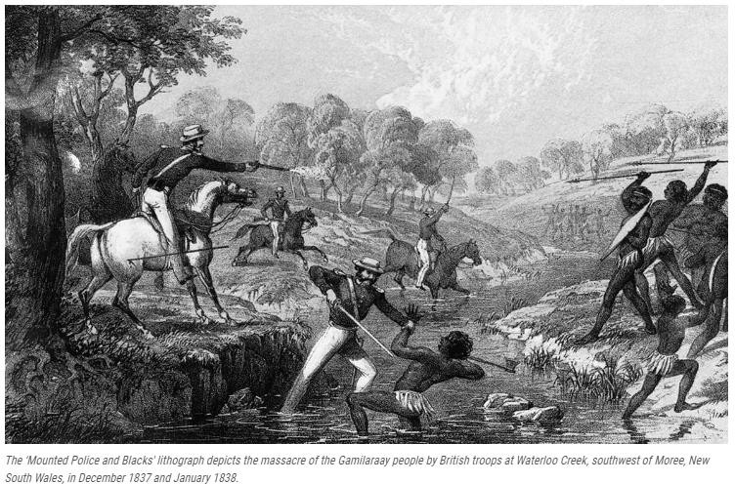
Colonial Massacres
Australia, 1788-1930
https://c21ch.newcastle.edu.au/colonialmassacres/map.php

Slide 13

Terra Nulluis
Meaning… ‘land belonging to no-one’ allowed British settlement under European law
(Taylor & Guerin, 2014 p.26)
This policy remained until the
Mabo Decision in the High Court
in 1992

Slide 14

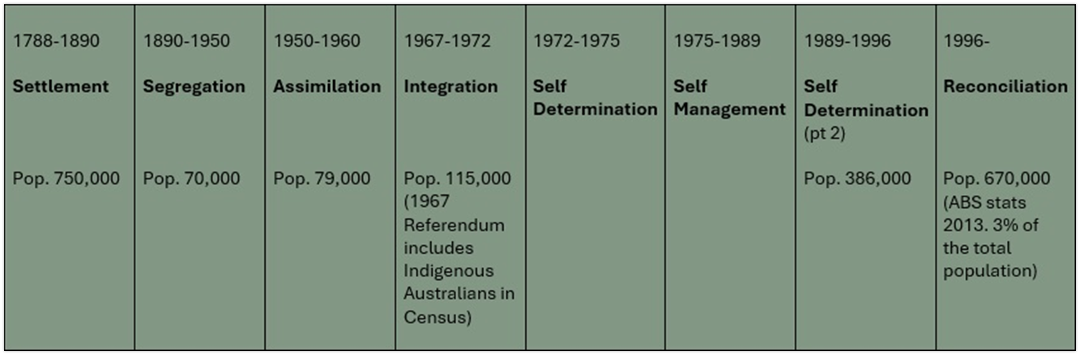

Slide 15
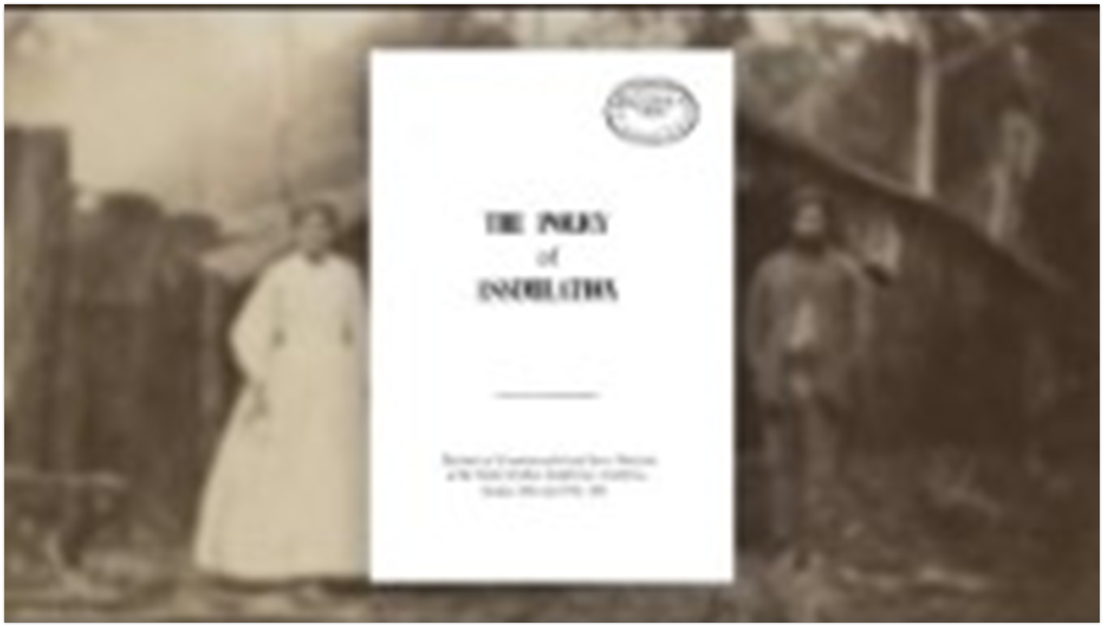
Assimilation

Slide 16
Assimilation in Practice
Between 1 in 10, possibly as many as 1 in 3, mixed lineage Aboriginal and Torres Strait Islander children were removed from their families and communities between 1910 and the 1970s.
How? Children were taken by the police; from their homes or on their way to school and put into institutions, fostered or adopted out to non-Aboriginal and non-Torres Strait Islander families.
Many children suffered harsh, degrading treatment (including sexual abuse) and were frequently indoctrinated to believe Aboriginal and Torres Strait Islander peoples were inferior (Healing Foundation, 2017)

Slide 17
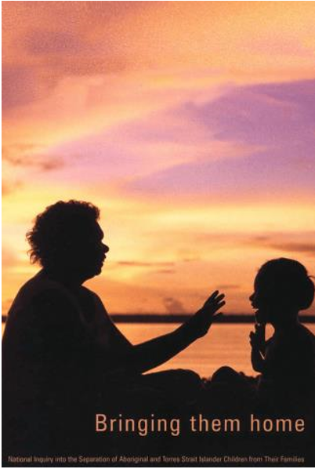
The Stolen Generations
1995 National Inquiry into the Separation of Aboriginal and Torres Strait Islander Children from Their Families
1997 Bringing them Home Report (Aboriginal & Torres Strait Islander Healing Foundation, 2017)
Social workers were some of the key workers working in child welfare and protection – did not speak out against it
Link to Report: https://www.humanrights.gov.au/sites/default/files/content/pdf/

Slide 18
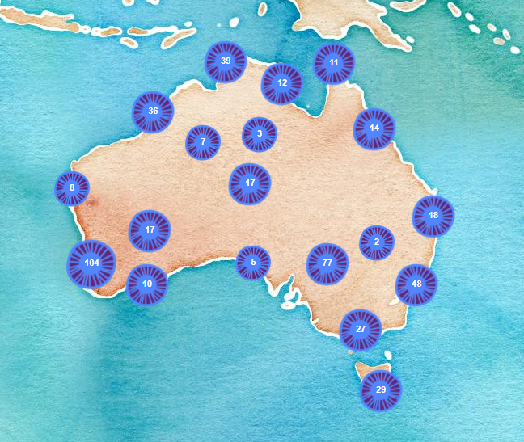
Map of Stolen Generations Institutions
Institutions Map | The Healing Foundation

Slide 19
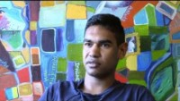

Slide 20

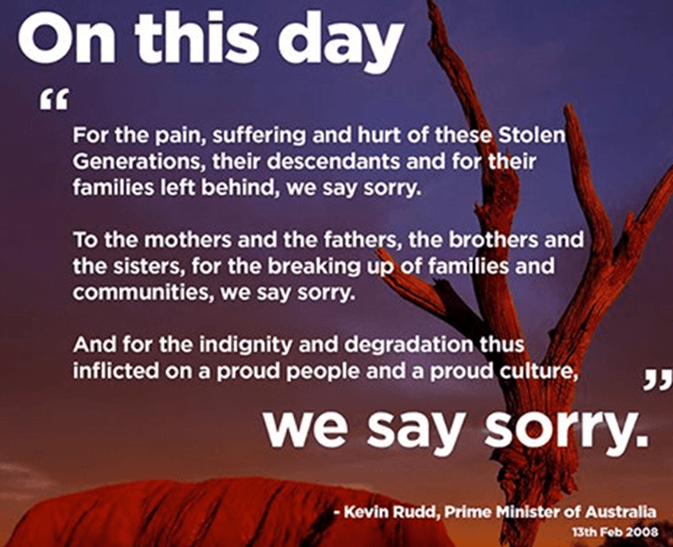
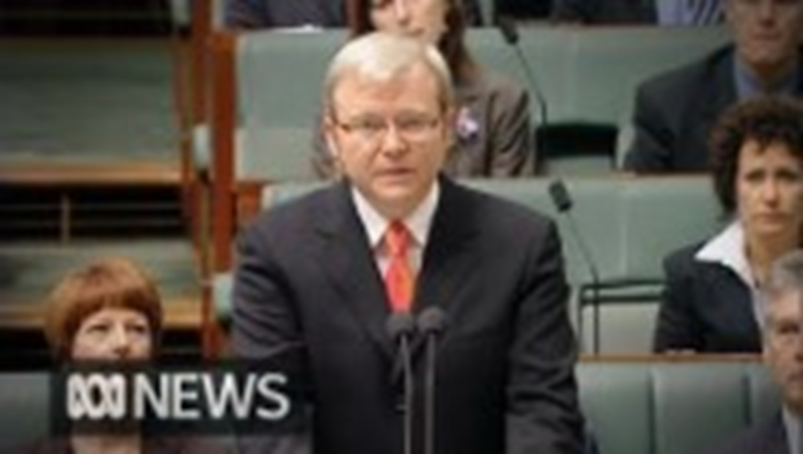
Australian Prime Minister Kevin Rudd apology speech - YouTube

Slide 21
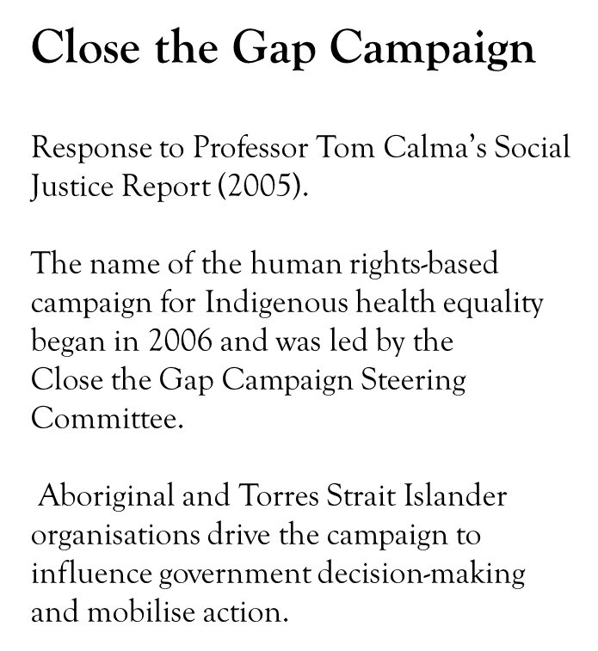


Closing the Gap Strategy
In February 2008, Prime Minister Kevin Rudd pledged the government would attempt to bridge the gap between Indigenous and non-Indigenous Australian health, education, living conditions, life expectancy, educational achievement, and economic opportunity.
‘Closing the gap’ refers to Australian Government initiatives, which do not necessarily reflect the human rights-based approach of the Close the Gap Campaign.

Slide 22
When considering Indigenous peoples health and wellbeing it is good to be familiar with the annual Close the Gap reports. To help you familiarise yourself with these resources.
History of Closing the Gap. https://healthinfonet.ecu.edu.au/learn/health-system/closing-the-gap/history-of-closing-the-gap/
Close the Gap 2024 Report
https://www.closingthegap.gov.au/national-agreement/targets
Lets discuss…

Slide 23
Secret life
Poor housing
Education system ignored Aboriginal ways of knowing, being and doing
Poverty
(stolen wages, kept wages, no wages)
Separation or loss of family connections
Grief & Loss
Social rejection
Disruption
The impacts on communities
Loss & Disconnection of culture
No recognition of traditional healing system = poor health outcomes
Trauma
Substance abuse
Mental Health
Poor housing
Incarceration
Disconnection

Slide 24
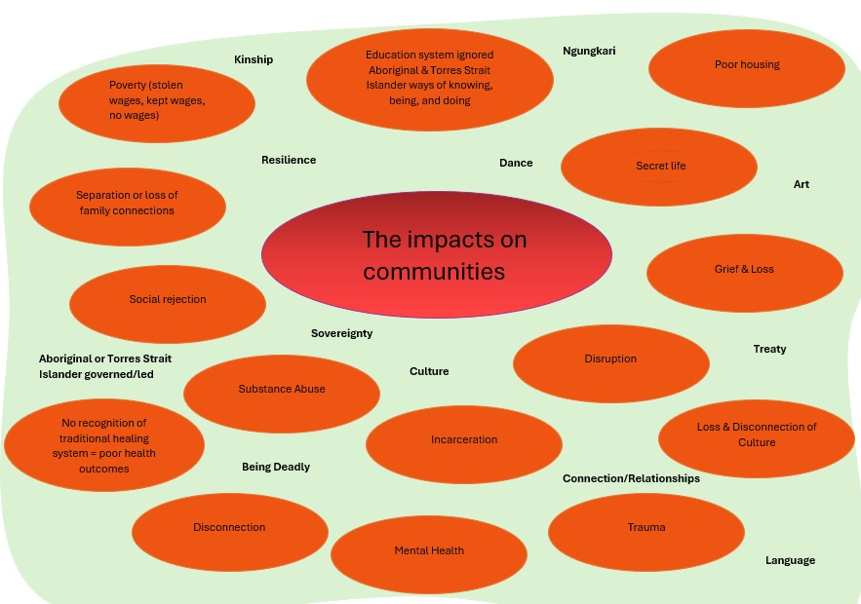

Slide 25
Translation to Practice
Prevention of harm therefore must seek to intervene in inter-generational cycles of harm by healing, strengthening, and reconnecting families and communities
More community governance and meaningful Aboriginal and Torres Strait Islander community participation

Slide 26
Privilege and Oppression
Are about unjust distributions of power
Privilege is unearned advantage
This is not about how good or bad someone’s life is, or whether or not they are happy
Individuals do not choose to get those advantages, and do not have them by merit
Privilege is concerned with whether a given society, economic system, or institution unjustly benefits certain groups
Oppression is unearned disadvantage
The same points hold true for oppression.
So, an individual is oppressed in the event that they get a range of disadvantages due to their socio-economic position
Their disadvantages are not a consequence of their choices. Merit is irrelevant

Slide 27
Racism and Power
Racism, as a form of oppression, is primarily concerned with unjust distributions of power on the basis of ethnicity. Where ideas and influences are/become normalised perceptions with structures, i.e. stereotypes, negative discourse, and biases.
It is not, primarily, about the specific beliefs of individuals or groups
There are people who discriminate on the basis of group membership i.e. Aboriginal, or Muslim, or Jewish, or Jamaican, or ‘Black,’ or ‘Indian,’ or for any other reason
Racism does not depend on these people alone. Many people benefit from racism without having these beliefs and are, in a broader sense, also racist.

Slide 28
Racism –Systemic racism, and how it presents as Institutional or Structural racism
Systemic racism is:
“When the policies and practices of institutions result in unfair treatment of some groups compared to others. Like everyday racism, systemic racism does not necessarily target a particular person.”
  Institutional racism [based on policies and entrenched societal ‘norms’] This is when racism is established as a normal behaviour within an organisation or society. It often results in discrimination by people who are doing jobs that others have given to them. For example, police are sometimes criticised for racial profiling, and police agencies now make efforts to eliminate institutional racism;
  Structural/Systemic racism [based on the organisations and structures that uphold these systems] This refers to inequalities found in societies that tend to exclude some groups of people. For example, when certain groups are under-represented in fields like the media, the legal profession, or politics, it can lead to inequalities in other areas too.

Slide 29
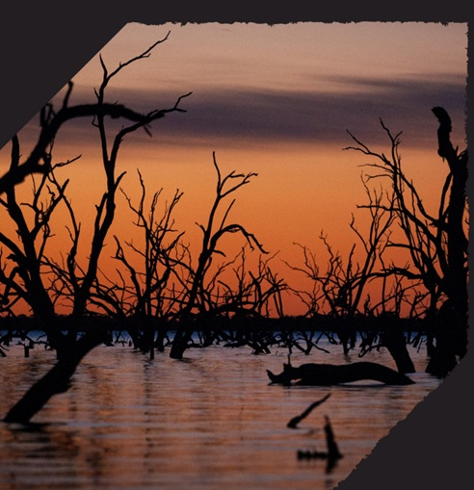
Inquiry into missing and murdered First Nations women and children 2022 ANTaR
“First Nations women commonly face negative experiences with police when attempting to report violence. This can include criminalisation for past offences.
In particular, Aboriginal and Torres Strait Islander women are at a high risk of police misidentification, and are more likely to be misidentified ‘simply because they are Aboriginal.’
Such responses reinforce the idea of First Nations people as the ‘ideal offender’ rather than the ‘ideal victim,’ who are thereby rendered unworthy of the same time, attention, or credibility given to non-Indigenous people.”
p. 7

Slide 30
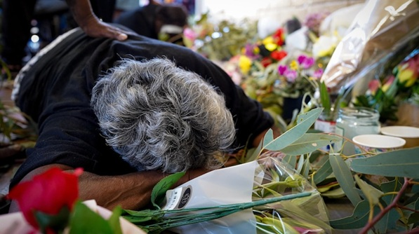
"I need you to see that this is not past history, this is the ongoing story of our country."

Slide 31
Healing Through Culture: The Woorabinda Men’s and Women’s Healing Camps (Central Queensland)
What Happened:
Woorabinda created cultural healing camps on Country.
Elders, cultural mentors, and Aboriginal health workers lead the program.
Activities include ceremony, storytelling, Yarning circles, bush foods, and time on Country.
Healing focuses on identity, belonging, and cultural pride.
Trauma is acknowledged but not centred — strength is the focus.
Why It Matters:
Strengths‑based healing: Culture, identity, and community are central.
Intergenerational trauma: Healing through connection, not deficit framing.
SEWB: Supports spirit, mind, body, family, community, and Country.
Yarning & Dadirri: Build trust, safety, and deep understanding.
Cultural continuity: Elders’ knowledge strengthens wellbeing.
Community leadership: Healing is Indigenous‑led and culturally grounded.

Slide 32
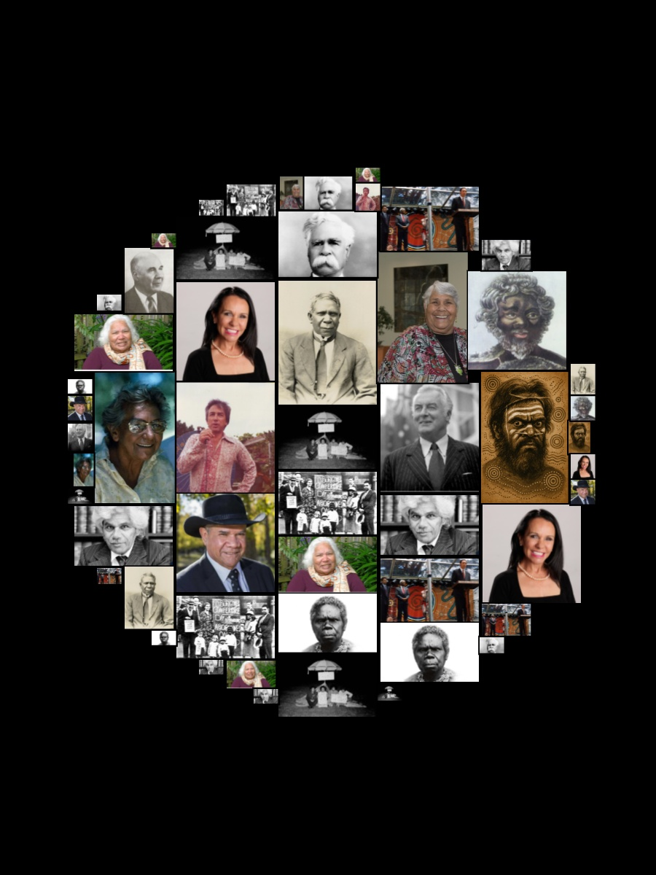
Activity: Resistance & Resilience: Advocates & Allies
How do these people/events shape your understanding of Australian history?
What surprised or challenged you?
How do these events still affect Indigenous communities today?

Slide 33
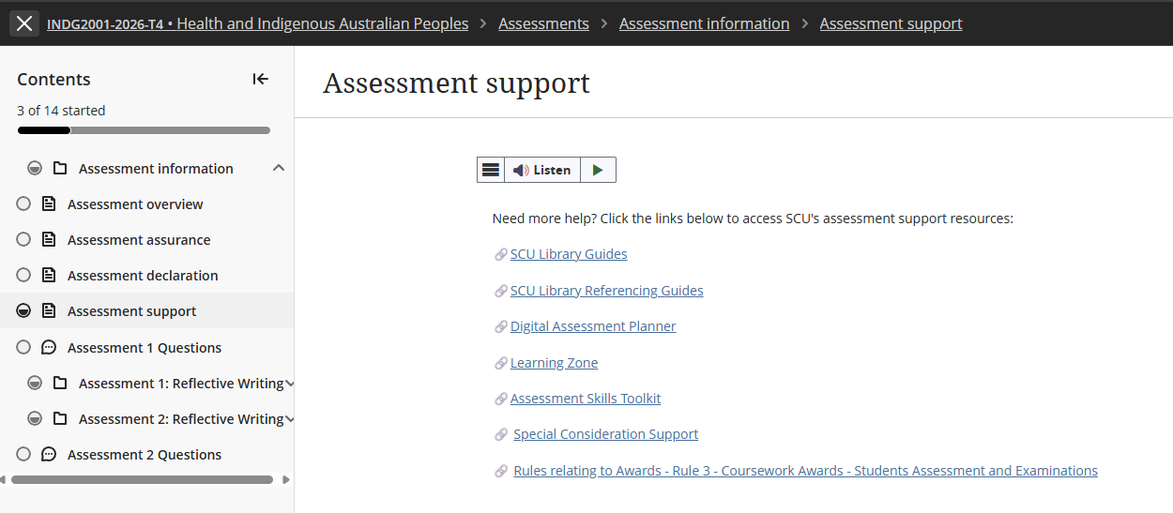
Special Considerations Support extension

Slide 34
Assessment 1 – Short Response
Title | Assessment 1
Type | Short response
Length | 1,000 words
Weighting | 40%
Academic Integrity | Level 2. Purpose-Specific GenAI Use GenAI may NOT be used EXCEPT Grammarly Premium AI.
Submission | Word document submitted to Blackboard
Unit Learning Outcomes | This assessment task maps to the following ULOs: ULO1: Discuss key concepts of health and wellbeing as determined by Aboriginal People. ULO2: Identify key stages of the colonisation process and its relationship to the contemporary health status of Australian Indigenous People.

Slide 35
Always use unit approaches (concepts, theories, models, processes or guidelines) in your short responses. Often, this means defining and applying unit concepts or theories.
Before you start working on the assessment, find definitions in the unit materials. This step will help you gain a more detailed grasp of unit ideas and theories so that you can show this understanding to the marker.
Don't try to COVER EVERYTHING you know about a topic. While it can be tempting, this is not your task in a short response, and you don't have enough words. Offer your informed answer to the question within a limited word count.
As you brainstorm, plan, and draft keep trying to narrow, narrow, narrow your focus.
You can use headings in a short response, it is part of the word count.
Overview to Writing a Short Response

Slide 36


10 Key Steps for Strong Short Response Writing
Start with a clear main point: Emphasise that short responses must begin with the answer, not background. Example sentence starters such as: “This concept refers to…” or “In the scenario, this is evident when…”.
2. Explain the key concept briefly: Define or clarify the concept in their own words before applying it. This prevents vague or incorrect use of terms
3. Link the concept to UNDRIP Article 3
Show clearly how the concept relates to the rights described in Article 3 and to Australian Indigenous Peoples understandings of health and wellbeing. Interpret the connection—do not retell general background information.
4. Use scholarly or unit evidence: Short responses still require academic grounding. Evidence can be a unit concept, framework, or scholarly idea. Keep it brief.
5. Write concisely and coherently: Use short, direct sentences - improves clarity and reduces grammatical errors - avoid long introductions, unnecessary detail, or narrative writing.

Slide 37
10 Key Steps for Strong Short Response Writing continued …
6. Maintain respectful terminology: Remember: Correct and consistent use of your chosen term
7. Conclude by linking back to the question: A final sentence should reinforce the main point to close the paragraph logically and signals relevance to the marker.
8. Avoid common pitfalls: Highlight typical issues: over‑description, missing the main point, unclear links to Article 3, lack of evidence, incorrect terminology, and overly long sentences.
9. Use postgraduate verbs: Encourage verbs that show analysis and interpretation: analyse, interpret, examine, integrate, contextualise. Discourage vague verbs like talk about or discuss.
10. Follow a simple structure (PEEL): Point → Explain → Evidence/Scenario → Link.

Slide 38
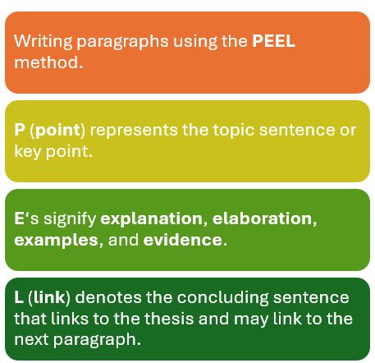
PEEL Writing Structure

Slide 39
Assessment 1 Overview
Purpose of the Assessment
Builds understanding of Australian Indigenous perspectives of health and wellbeing.
Introduces self‑determination as a core principle in UNDRIP Article 3.
Highlights differences between Australian Indigenous wholistic health and Western biomedical models.
Examines how colonisation has limited the ability to exercise self‑determination.
Develops foundational knowledge for culturally safe practice in health, social services, and community work.
Strengthens critical thinking and culturally grounded analysis for professional contexts.
Task Description
Read Article 3 of the United Nations Declaration on the Rights of Indigenous Peoples (UNDRIP):
"Indigenous peoples have the right to self-determination. By virtue of that right, they freely determine their political status and freely pursue their economic, social and cultural development."
Write a 1,000-word short response explaining how this article relates to Australian Indigenous Peoples understandings of health and wellbeing.

Slide 40
Assessment 1 - Instructions
Step 1: Read UNDRIP Article 3
Consider what the term self-determination means and why it is important for Australian Indigenous Peoples.
Step 2: Review Unit Content
Use learning materials from:
  Module 1: Australian Indigenous concepts of health and wellbeing.
  Module 2: Colonisation and its impacts on Australian Indigenous health and wellbeing.
Step 3: Research
Locate additional scholarly literature that supports your discussion.
  Definition of Scholarly and Peer-Reviewed sources
  Peer-reviewed sources are academic publications that have been evaluated by experts before publication to ensure quality, accuracy, and credibility. Scholarly sources are written by researchers or experts for an academic audience and include journal articles, academic books, conference papers, and theses. They typically provide author credentials and references. All peer-reviewed sources are scholarly, but not all scholarly sources are peer-reviewed. For example, an academic book may be scholarly without undergoing peer review.
Step 4: Write Your Response
Your response should explain how Australian Indigenous concepts of health and wellbeing, self-determination, and community-accepted communication styles are interconnected, and how these relate to the ongoing impacts of colonisation on Australian Indigenous health and wellbeing.

Slide 41
Example Short Response Structure
Introduction (Approx. 100 words)
Introduce UNDRIP Article 3.
Outline the main points of your response.
Health and Wellbeing (Approx. 300 words)
Examine the key concepts of health and wellbeing from Australian Indigenous perspectives.
Reflect on why self-determination is important for Australian Indigenous health and wellbeing.
Critically evaluate one cultural determinant which shapes Australian Indigenous health and wellbeing.
Community-accepted communication styles (Approx. 300 words)
Critically analyse the role of community-accepted communication styles in supporting Australian Indigenous health and wellbeing.
Colonisation and Health (Approx. 200 words)
Critically reflect on the enduring effects of colonisation on Australian Indigenous health and wellbeing.
Conclusion (Approx. 100 words)
Summarise your key points. NO new information

Slide 42
Your response must …
Assessment Requirements
Follow the Short Response Quick Guide (Assessment 1 resources).
Address UNDRIP Article 3 throughout your discussion.
Analyse Australian Indigenous concepts of health and wellbeing, including self‑determination and one cultural determinant.
Explain the relationship between colonisation and contemporary Australian Indigenous health outcomes.
Support your discussion with scholarly evidence.
Sources & Referencing
Use a minimum of five (5) scholarly sources.
UNDRIP must be cited and referenced, but does not count toward the five scholarly sources.
Your reference list must contain at least six (6) references in total.

Slide 43
Ensure you meet the following Criteria:
Referencing style of APA7.
Consistent use of correct and appropriate terminology and tone in reference to Indigenous Australian Peoples, communities, and issues.
Use a minimum of 5 peer-reviewed scholarly sources, 1 MUST be the The United Nations Declaration on the Rights of Indigenous Peoples (UNDRIP) 2007.
Wikipedia, Creative Spirits and or other such websites are not acceptable scholarly reference material.
Referencing Requirements

Slide 44
Other Requirements …
Ensure you have attached your signed and correctly completed Coversheet to the front of your assessment document prior to uploading your final submission.
Label your submission with your surname and initials, and the assessment task's name e.g. SmithJ_ShortResponse.docx
You are required to use APA 7th referencing style in this Unit formatting your document, citations, and references
Instead of a Header you MUST add a footer to your submission.
Add your name and task type – i.e. SmithJ_ShortResponse on left margin, your student ID, and have page number on the right margin e.g.

Slide 45
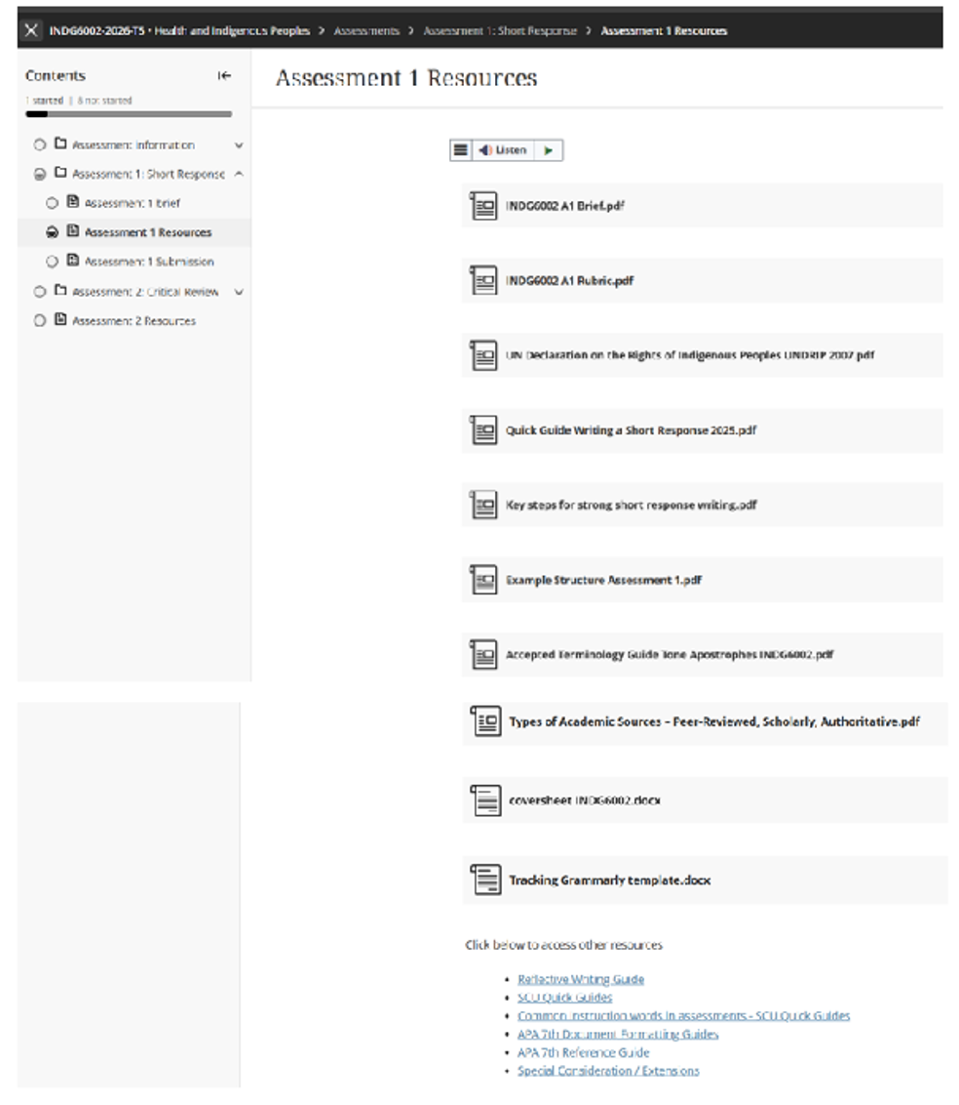
Assessment 1 – Resources & Other Requirements

Slide 46
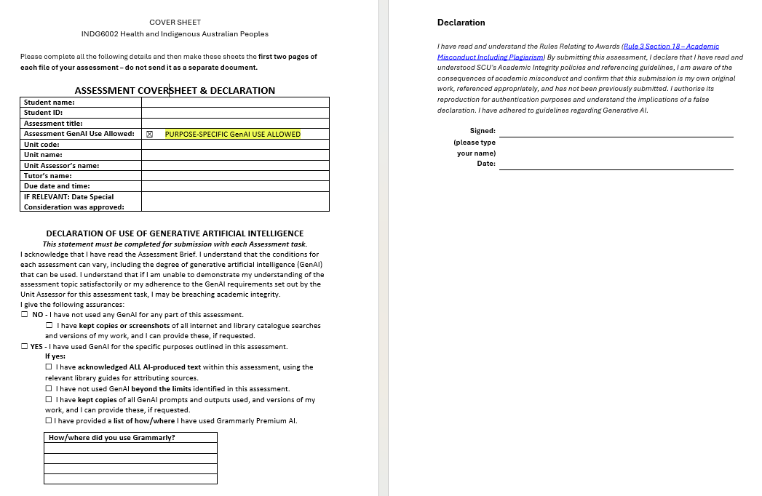
Assessment Coversheet & Declaration

Slide 47
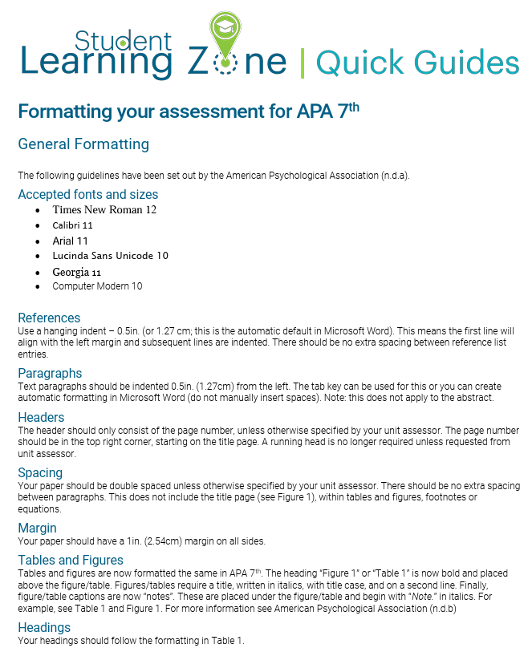
APA 7th Formatting your Document

Slide 48
INDG6002 - GenAI Use
In Gnibi College units, the use of GenAI in assessments is generally restricted to protect the integrity and authenticity of the learning process. Indigenous Knowledges are grounded in lived experience, cultural practices, and relational ways of knowing. Engaging meaningfully with these knowledges requires personal reflection, respectful interpretation, and a commitment to culturally responsive learning—something that cannot be authentically achieved through AI-generated content.

Slide 49
INDG6002 - GenAI Use continued …
This assessment is classified as:
Level 2: AI use permitted for specific purposes. You can use AI for specific tasks as identified by the Unit Assessor.
✅ You may use GenAI to:
Formatting, spelling and grammar - Grammarly Premium AI is permitted for formatting, spelling and grammar. Grammarly is permitted for language improvements – no content or knowledge creation is permitted.
Paraphrasing permitted - Use of Grammarly Premium AI is permitted for paraphrasing. Pay careful attention to any language adjustments that may affect the clarity of your work. Paraphrasing using Grammarly Premium AI must be referenced.
❌ You may not use GenAI to:
Use of any other GenAI for content or knowledge creation is not within the permitted uses for this task.
Present GenAI-generated material as your own original ideas
Ask GenAI to write any part of the analysis, commentary, or conclusions about your chosen study.
Upload or provide text from the research article or for GenAI to rewrite, summarise, or interpret the article.

Slide 50
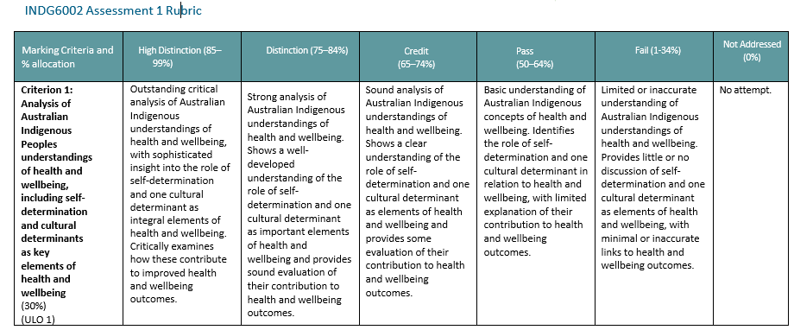
Rubric Assessment 1: Criterion 1

Slide 51
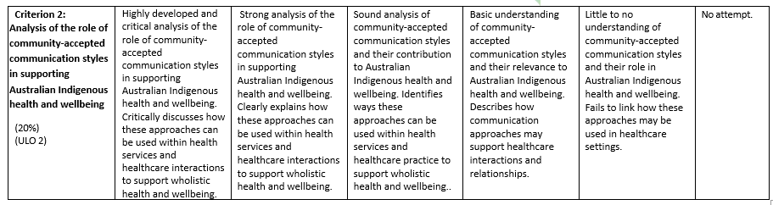
Rubric Assessment 1: Criterion 2

Slide 52
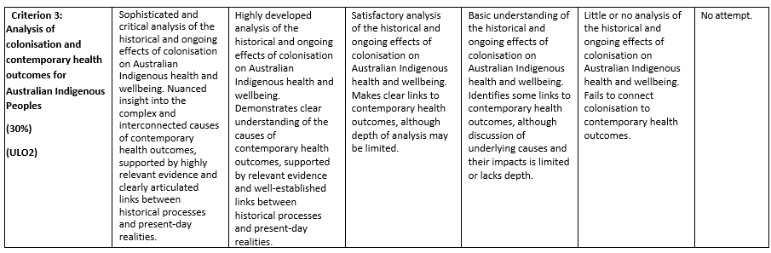
Rubric Assessment 1: Criterion 3

Slide 53
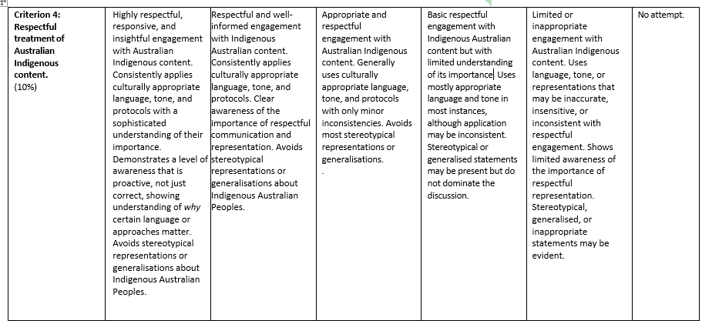
Rubric Assessment 1: Criterion 4

Slide 54
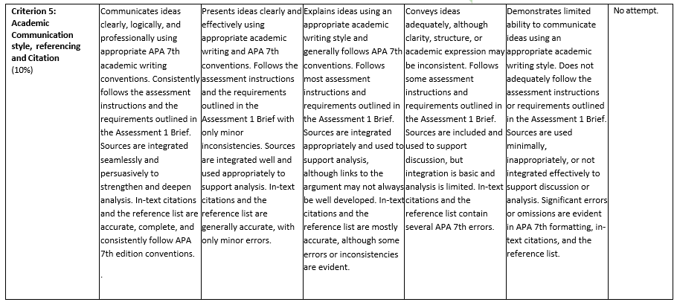
Rubric Assessment 1: Criterion 5

Slide 55
Questions?

Slide 56
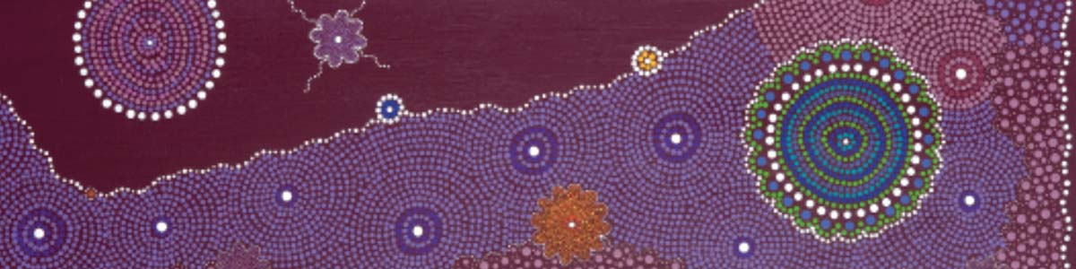
Next week:
Module 3: Social and cultural determinants of health

Slide 57
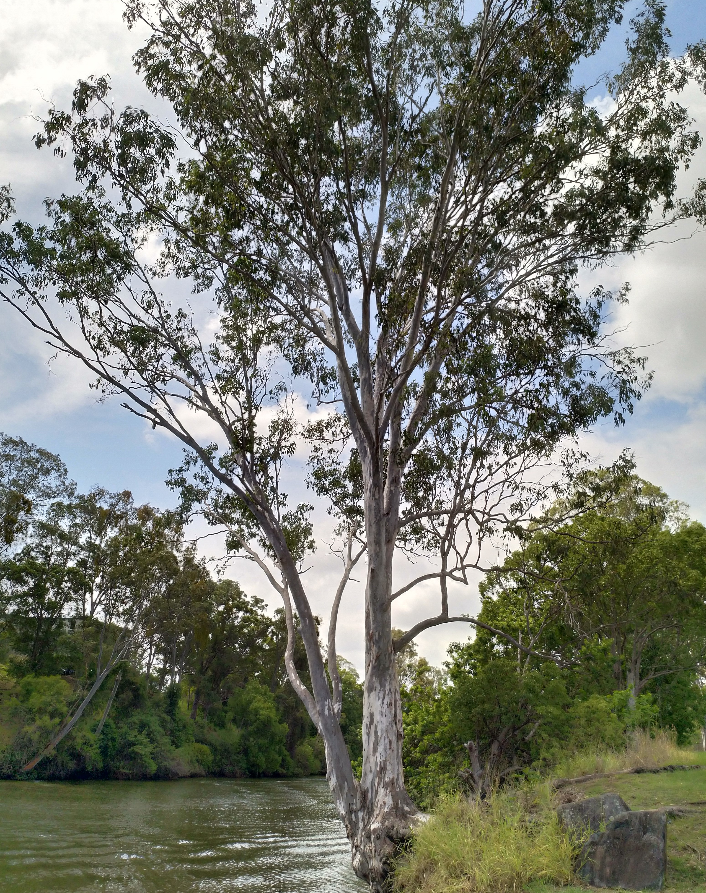
Until Next Time …

